Slide 1
Name Based Gender Identification - nlp
Anushka Sawant
Date of Presentation- 19/08/2023

Slide 2
Content
Introduction
Problem Statement
Methodology
Code Implementation
LSTM
CNN
Scope of project
Conclusions
Future Scope

Slide 3
What is Name gender identification
Name gender identification is the process of using computers to predict whether a given name belongs to a male or female person. This is done using Natural Language Processing (NLP) techniques to analyze patterns in names and their associated genders.
Applications of Name Gender Identification -
Marketing and Personalization
Demographics Analysis
Healthcare and Medical Research

Slide 4
Problem Statement
Develop a machine learning model that can accurately predict the gender (male or female) associated with a given name. The model should take a name as input and provide a label indicating the likelihood of the name belonging to each gender category.

Slide 5
Methodology
The work pipeline involved in this project is as follows:
Import libraries.
Load the dataset.
Exploratory data analysis.
Data Augmentation
Encoding the labels.
Count vectorization of predictor text values.
Splitting the dataset into training and testing sets.
Building models using logistic regression, naive Bayes, and XGBoost
Comparison of results of the above models.
Building an LSTM model.
Building an CNN model.

Slide 6
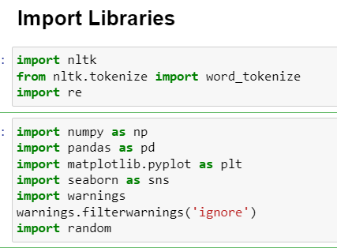
Import Libraries
We first must import the necessary libraries to work with any data and build a solution. Our project will use Numpy, Pandas, Matplotlib, Seaborn, Scikit-Learn, TensorFlow, nltk and Keras.

Slide 7
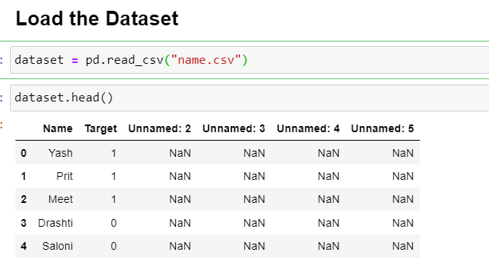
Load the Dataset
pd.read_csv - This function will read the data from the CSV file and store it in a data structure that you can manipulate and analyze using the respective language's capabilities.

Slide 8
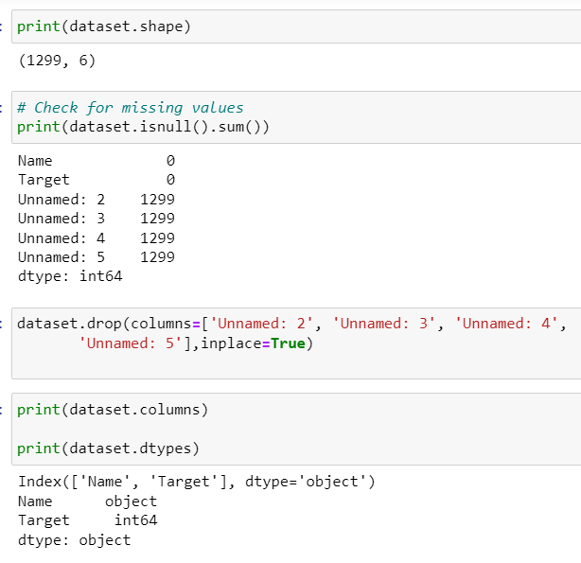
Exploratory Data Analysis

Slide 9
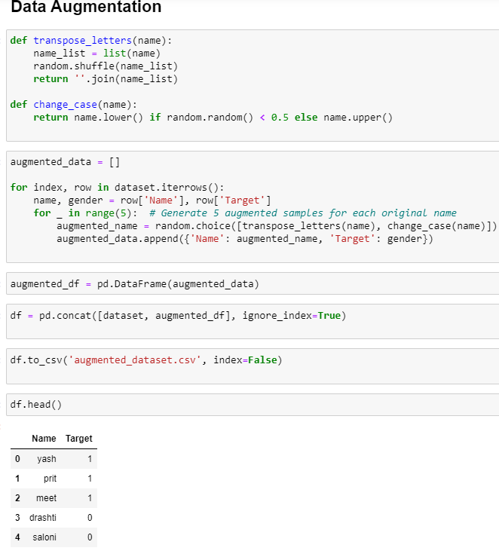
Data Augmentation
Data augmentation in Natural Language Processing (NLP) is a technique used to artificially increase the size and diversity of a training dataset by creating variations of the original text data
In our dataset ,since the Name column contained only 1299 observations , we opted for data augmentation.

Slide 10


After data augmentation the shape of our data became 7794 observations.
Replacing Column Values
Here, 0 and 1 in the ‘Target’ column refer to male and female, respectively. However, for convenience, we shall replace them with ‘M’ and ‘F.’

Slide 11

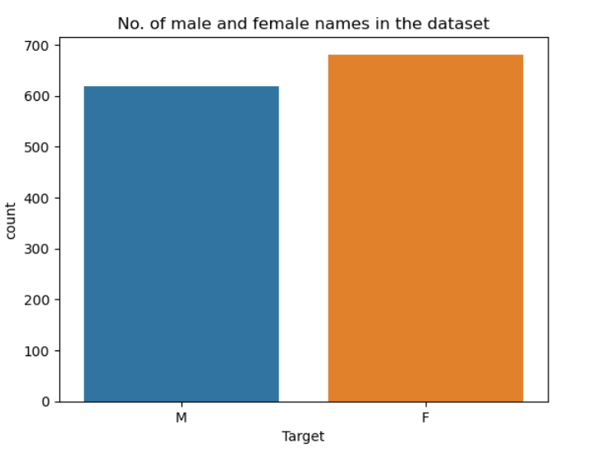
By creating the plot we will see how many male and female names are present in the dataset.

Slide 12
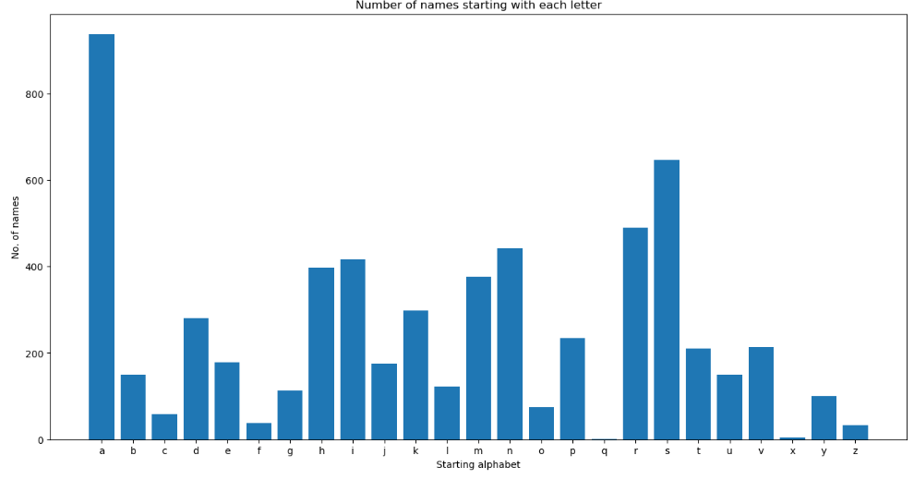
Analyzing the Starting and Ending Letter of Names
Visualizing the above information using a bar chart shows that around 937 names start with the letter “a”

Slide 13
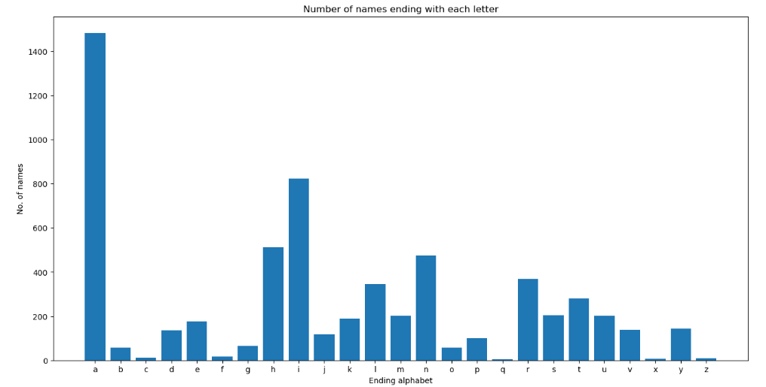
The below bar graph depicts that most of names end with the letters “a”

Slide 14
Most Indian names start with the alphabets a, i, h, n, and r from dataset

Slide 15
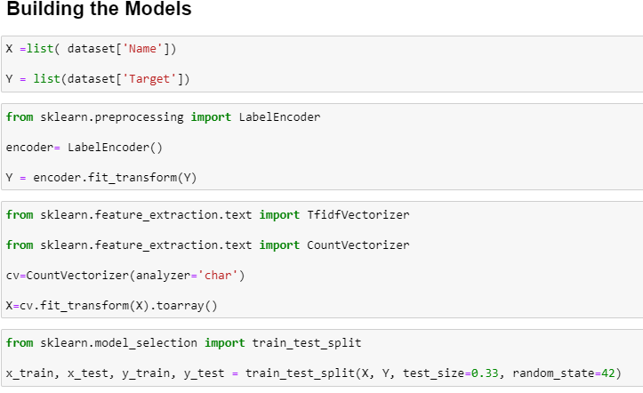
Building the Models
Define the predictor variable ‘X’ and the target variable ‘Y.’
Will use the LabelEncoder feature in Sklearn to convert the ‘F’ and ‘M’ labels into a machine-readable format.
We vectorize the names into vector-like data to make the modeling process easier. The variable ‘X’ is transformed into an array of vectors.
We split the data

Slide 16
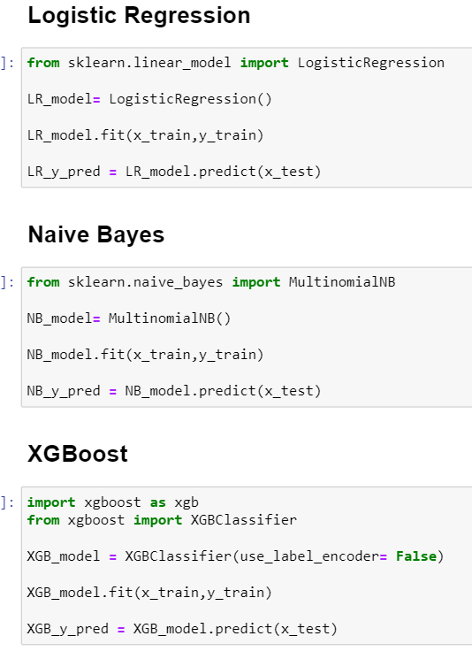
First we run Logistic Regression , Naive Bayes and XGBoost models

Slide 17
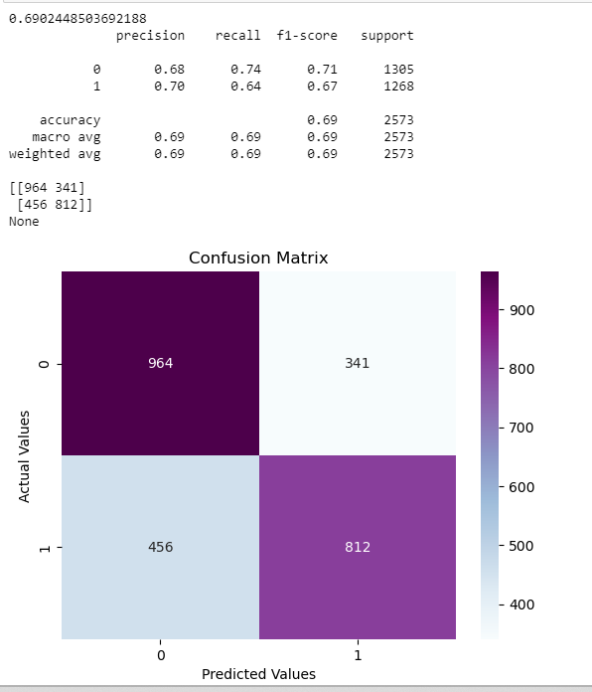
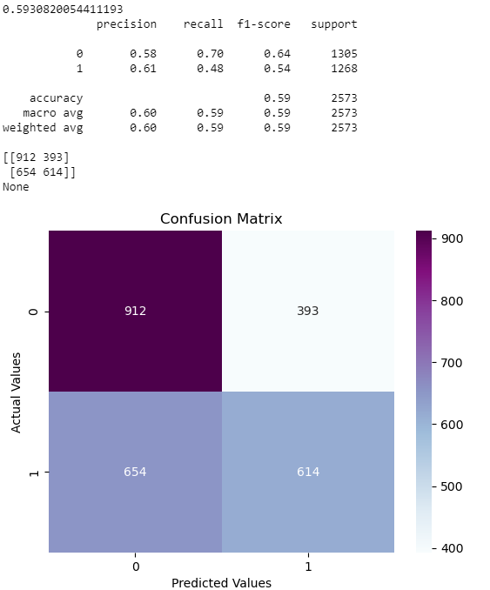
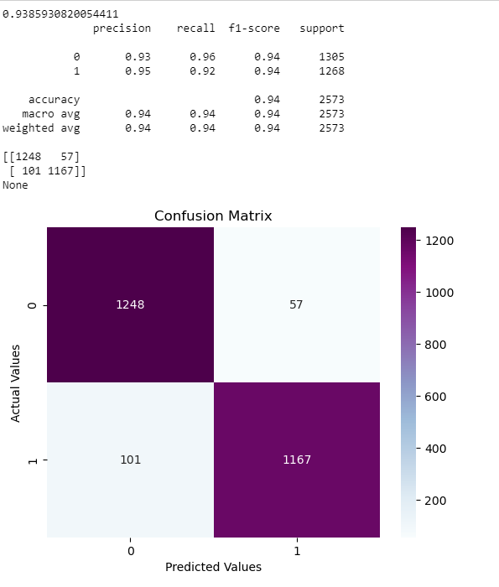
Comparison of Performance

Slide 18
Looking at the above outputs, the accuracy of logistic regression is 69%. It classified around 341 women’s names as men and 456 men’s names as women.
Out of all the three mentioned algorithms, XGBoost seems to have performed better. It had a pretty good accuracy of 93%, with 158 wrong predictions made from 2415 testing samples

Slide 19
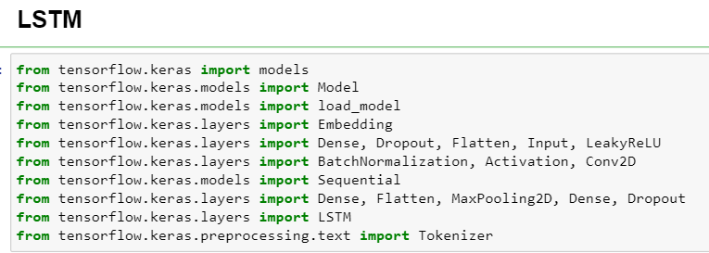
LSTM
Although we have obtained good accuracy using XGBoost, we can further improve the classification using LSTM
Importing the necessary libraires

Slide 20
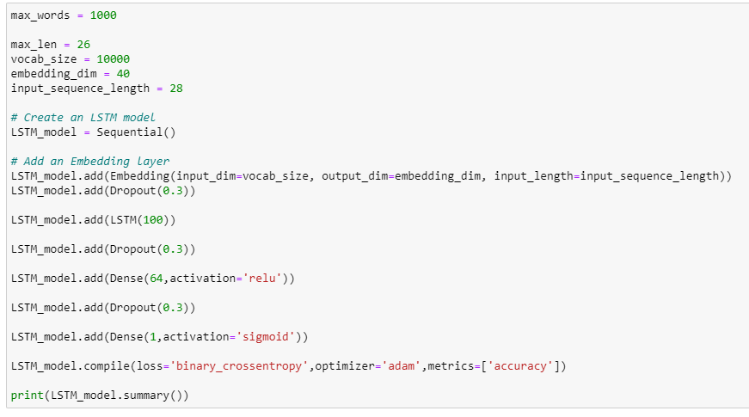

Slide 21
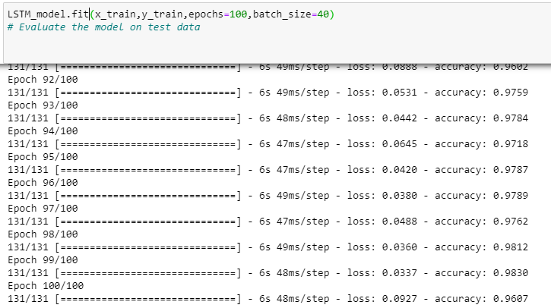

we are going to train it using the x_train and y_train features. We shall use 100 epochs to ensure that the model can generalize accurately.
We can see that LSTM has given an accuracy of 97%, which is 4% more than XGBoost.

Slide 22
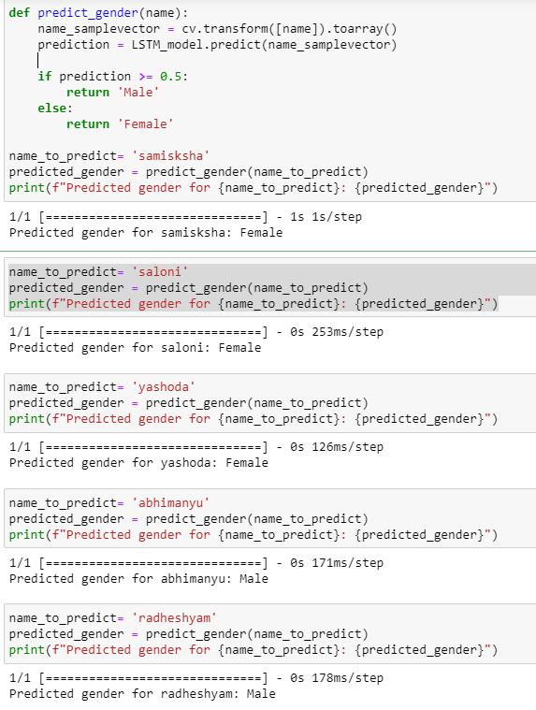
Sample test

Slide 23
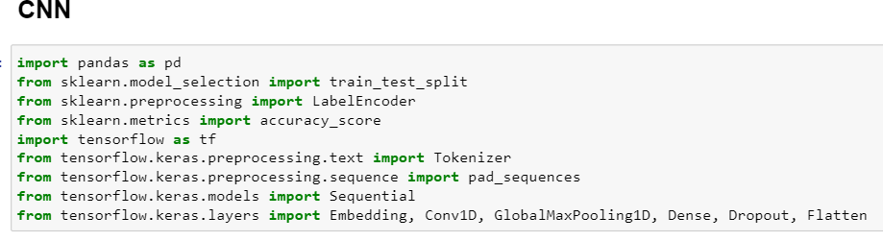
CNN
Although we have obtained good accuracy using LSTM, we can further improve the classification using CNN also.
Importing necessary libraries

Slide 24
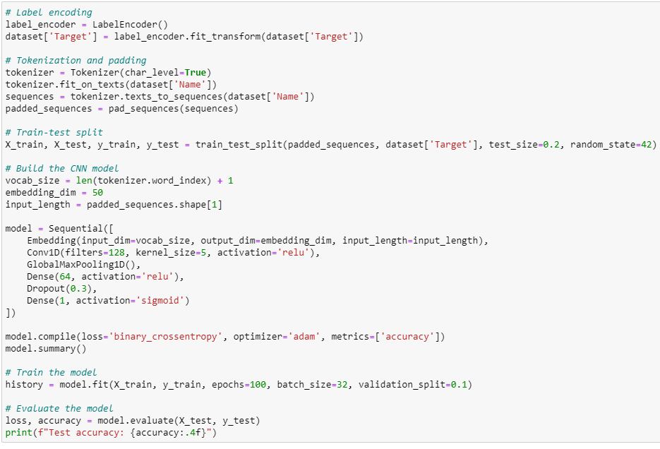

Slide 25
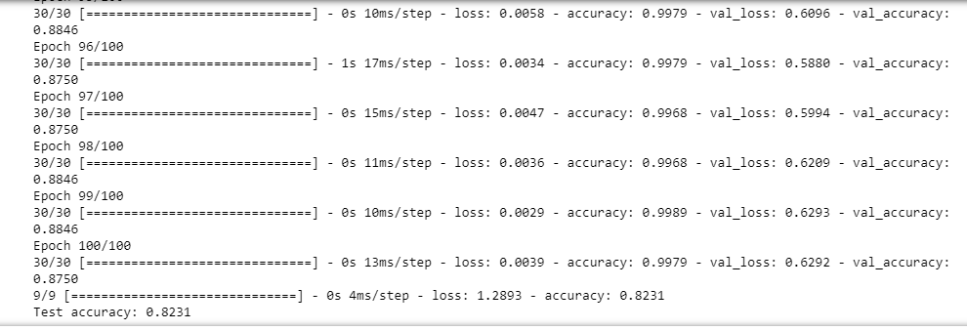
We can see that CNN has given 82% accuracy whereas LSTM has given an accuracy of 97%

Slide 26
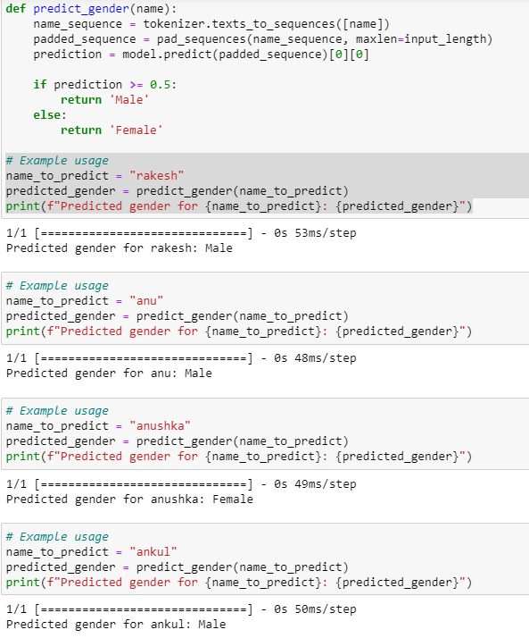
We can see that the model has predicted the name ‘anu’ as male. However, there could be some cases where the model makes wrong predictions.

Slide 27
Scope of project
The scope of a name gender identification project can extend to various domains and applications. Here are some examples of where the project can find valuable applications:
Government and Policy
Entertainment Industry
Online Communities and Forums

Slide 28
Conclusion
First, we started by defining our problem statement. Then we moved on to practically implementing the identification and classification of gender based on names using logistic regression, naïve Bayes, and XGBoost algorithms. Moving forward, we compared the performances of these models. Lastly, we built an LSTM network and CNN. LSTM proved that it works best for name-based gender identification NLP problems.
The key takeaways :
Identification of gender using names is important for many businesses.
XGBoost gives better accuracy compared to logistic regression and naïve bayes when used for gender classification problems.
LSTM is a recurrent neural network that works best for text classification as compared to CNN which gave a good accuracy of 82%.
LSTM provides an accuracy of 97%, giving out the most accurate results

Slide 29
Future Scope
The field of name gender identification holds significant potential for future advancements and applications, driven by ongoing developments in natural language processing (NLP) and increasing awareness of gender-related issues. Here are some potential future scopes for the name gender identification project:
Collaboration with LGBTQ+ Organizations
Privacy and User Consent:

Slide 30
THANK YOU

